Slide 1
Crime Causation Understanding the Causes of Criminal Behavior

Slide 2
Introduction
Introduction
Introduction
Crime causation contributes to why individuals or groups engage in criminal activities.
Understanding these causes is vital for preventing and addressing crime effectively.
Categories: Individual and Societal Causes.

Slide 3
Individual Causes of Crime
1. Intelligence and Mental Deficiency:
Lower IQ is linked to impulsive crimes.
2. Heredity:
Genetic predisposition and family history of criminal behavior.

Slide 4

Biological Factors
?

Slide 5
Biological Factors
1. Chromosomes and Endocrine Disorders:
Chromosomal anomalies
Example: XYY syndrome).
Hormonal imbalances influencing aggression or impulse control.
Examples: Case studies showing biologically linked behaviours.

Slide 6
Demographic Factors
Sex:
Males are more implicated in violent crimes due to biological and social factors.
Age:
Young adults (15–25) are more likely to engage in risk-taking and criminal activities.

Slide 7
Substance Abuse
1. Alcoholism:
Impact on judgment, aggression, and domestic violence.
2. Narcotic Drugs:
Crimes committed under the influence or to fund addiction.
Example: A study on substance abuse and property crimes.

Slide 8
Psychological Theories
1. Freudian Theories:
Unresolved conflicts and unconscious motives.
2. Personality Traits:
Psychopathy, impulsivity, and lack of empathy.
Example: A case study of a serial offender.

Slide 9
Environmental Factors
1. Family Background:
Abuse, neglect, and dysfunctional families.
2. Peer Influence:
Gang involvement and social pressure.
3. Local Environment:
Poverty, unemployment, and urban decay.

Slide 10
Society-Centric Causes
1. Economic Inequality:
Correlation between poverty and crime rates.
2. Cultural Norms:
Societal tolerance for violence or deviance.
Example: Disparities in income leading to theft rates.

Slide 11

Economic Factors
1. Unemployment:
Lack of stable income leads to financial desperation.
2. Poverty:
Long-term poverty is linked to higher crime rates.
Example: Statistics showing correlation.

Slide 12
Educational Factors
1. Lack of Education:
Limited access to education leads to fewer opportunities.
2. School Dropouts:
Higher likelihood of criminal involvement among dropouts.

Slide 13
Media Influence
1. Violent Content:
Exposure to violent media can normalize aggression.
2. Social Media:
Cyberbullying and online radicalization.

Slide 14
Cultural and Social Norms
1. Tolerance for Deviance:
Cultural acceptance of certain illegal behaviours.
2. Peer Pressure:
Social expectations and conformity.

Slide 15
Prevention and Solutions
1. Education:
Increasing access to education.
2. Economic Support:
Addressing poverty and unemployment.
3. Rehabilitation:
Focus on reintegration programs for offenders.

Slide 16
REAL TIME EXAMPLE

Slide 17
CRIME SCENES
FIRST CRIME
Venus has extremely
high temperatures
SECOND CRIME
Saturn is a gas giant with several rings

Slide 18
FILE THE CRIMES
 | WHERE? | WHEN? | WHO?
CRIME 1 | United States | 25 March 2020 | Susan Doe
CRIME 2 | Spain | 15 October 2022 | Ben Jones
CRIME 3 | India | 10 April 2018 | Timmy Jimmy
CRIME 4 | United States | 27 January 2022 | Anna Scott

Slide 19
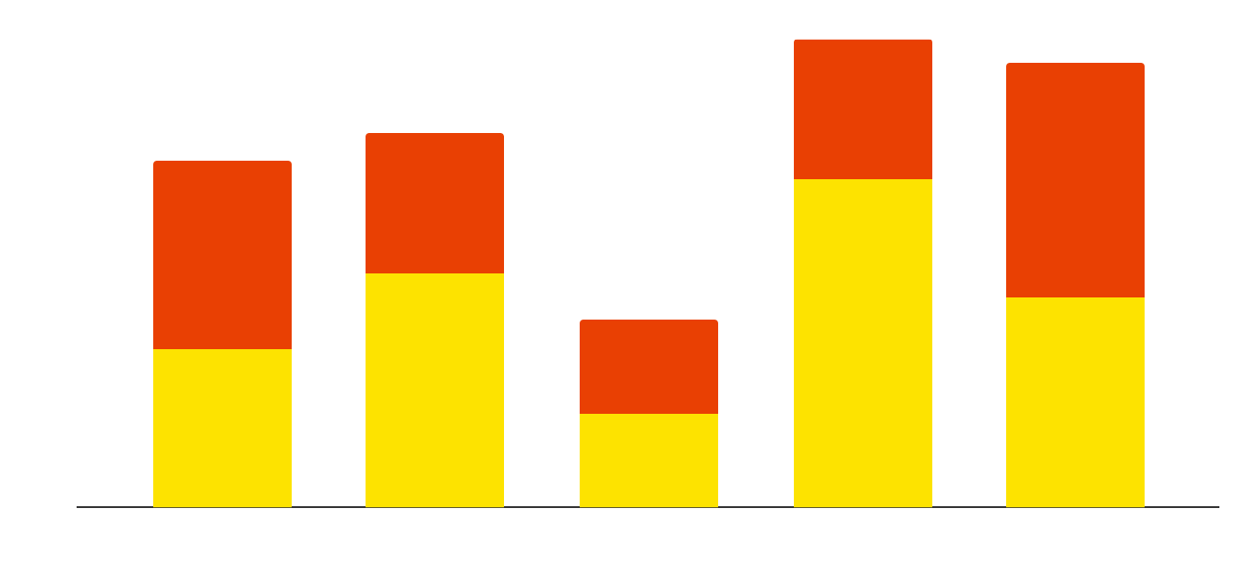
MOST COMMON CRIMES
MARS
Mars is actually a very cold place
MERCURY
Mercury is the closest planet to the Sun
Follow the link in the graph to modify its data and then paste the new one here. For more info, click here

Slide 20
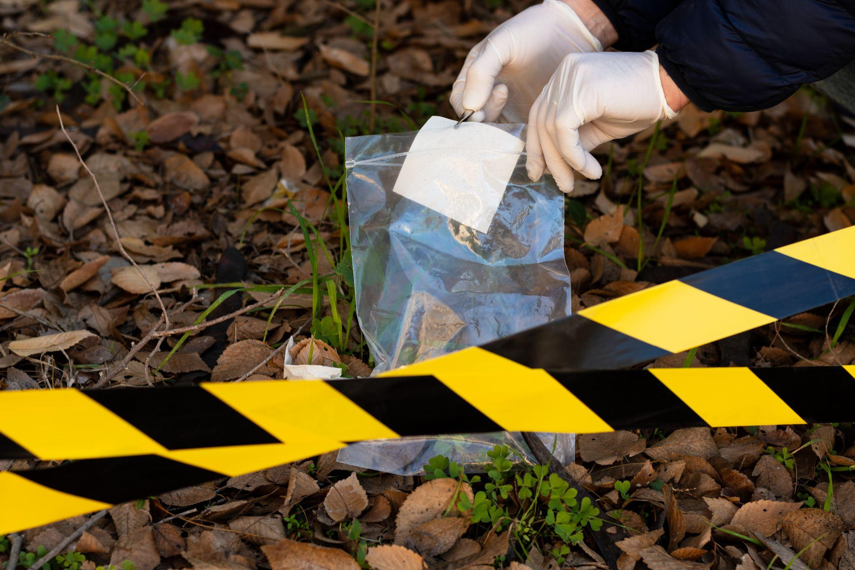
A PICTURE ALWAYS REINFORCES
THE CONCEPT
Images reveal large amounts of data, so remember: use an image instead of a long text. Your audience will appreciate it

Slide 21

A PICTURE IS WORTH A THOUSAND WORDS

Slide 22

THANK YOU

